Slide 1

MetaboTrack API
XJCO3011 Coursework 1
Xun Hu
Student ID: 2022116044

Slide 2








Overview & Deliverables
Project Overview
GitHub Repository
API Documentation
Technical Report
Core: Data-driven RESTful API
Scale: Manages 15,000+ physiological records
Innovation: Beyond CRUD — An Analytical Insight
Engine Key Features: Predictive simulations & Macro-level health trends
Data Source: Kaggle - Calorie Efficiency Dataset
Deliverables
Technical Stack
JAVA 17
SpringBoot 3
MySQL 8
MyBatis-Plus

Slide 3

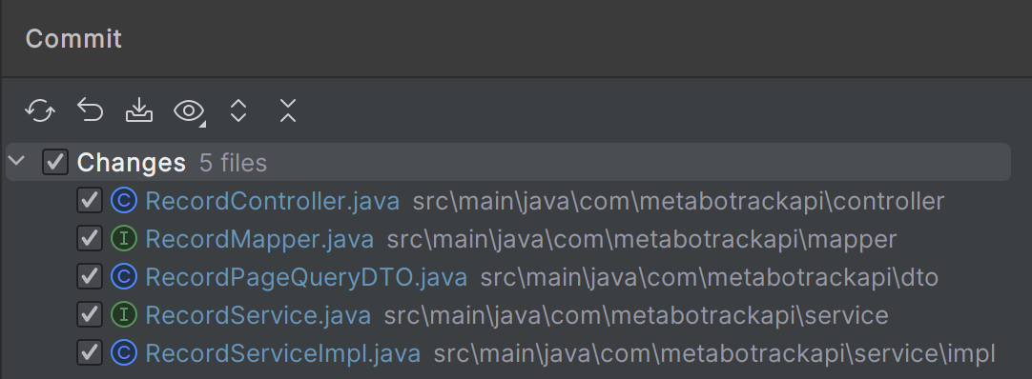
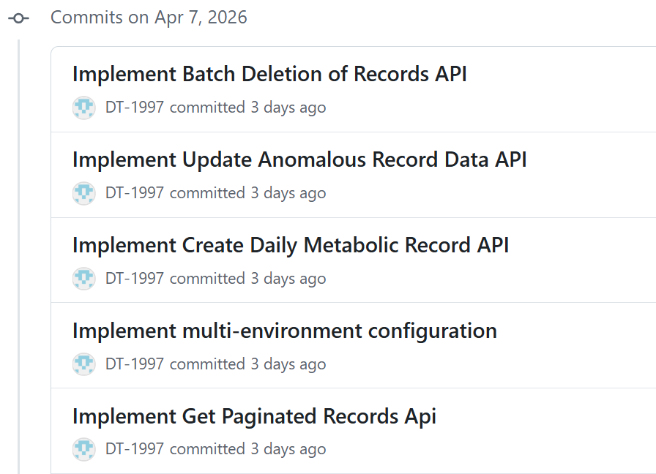
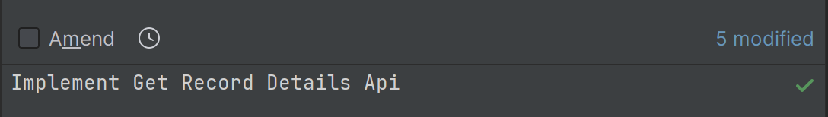
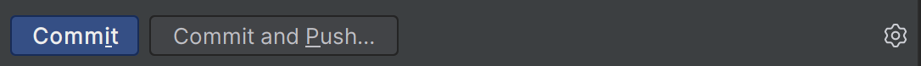
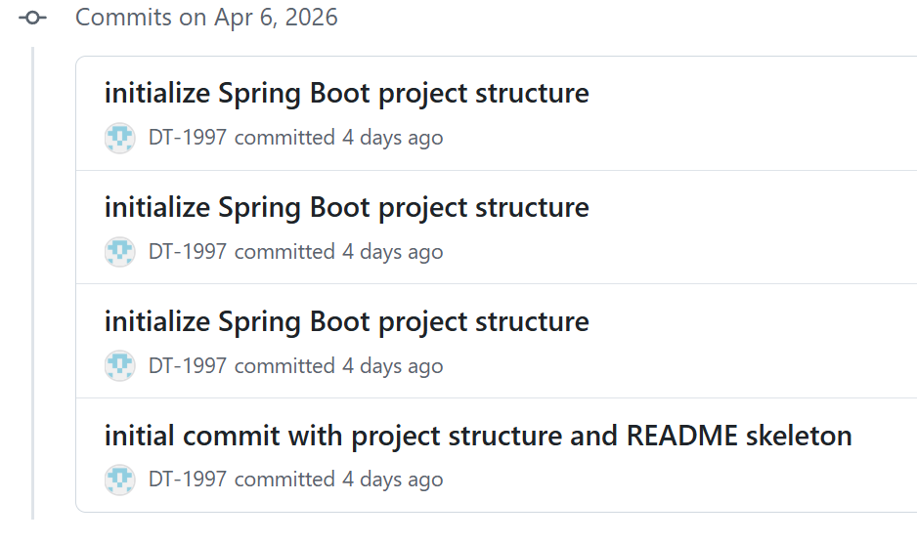
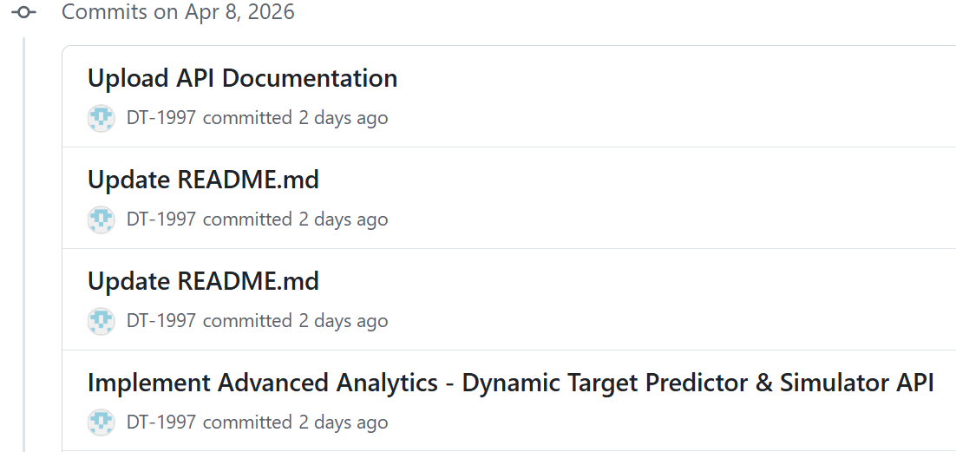
Version Control Practices
Version Control with IDEA
Commit History
(Partial)
Commit History
(Partial)

Slide 4
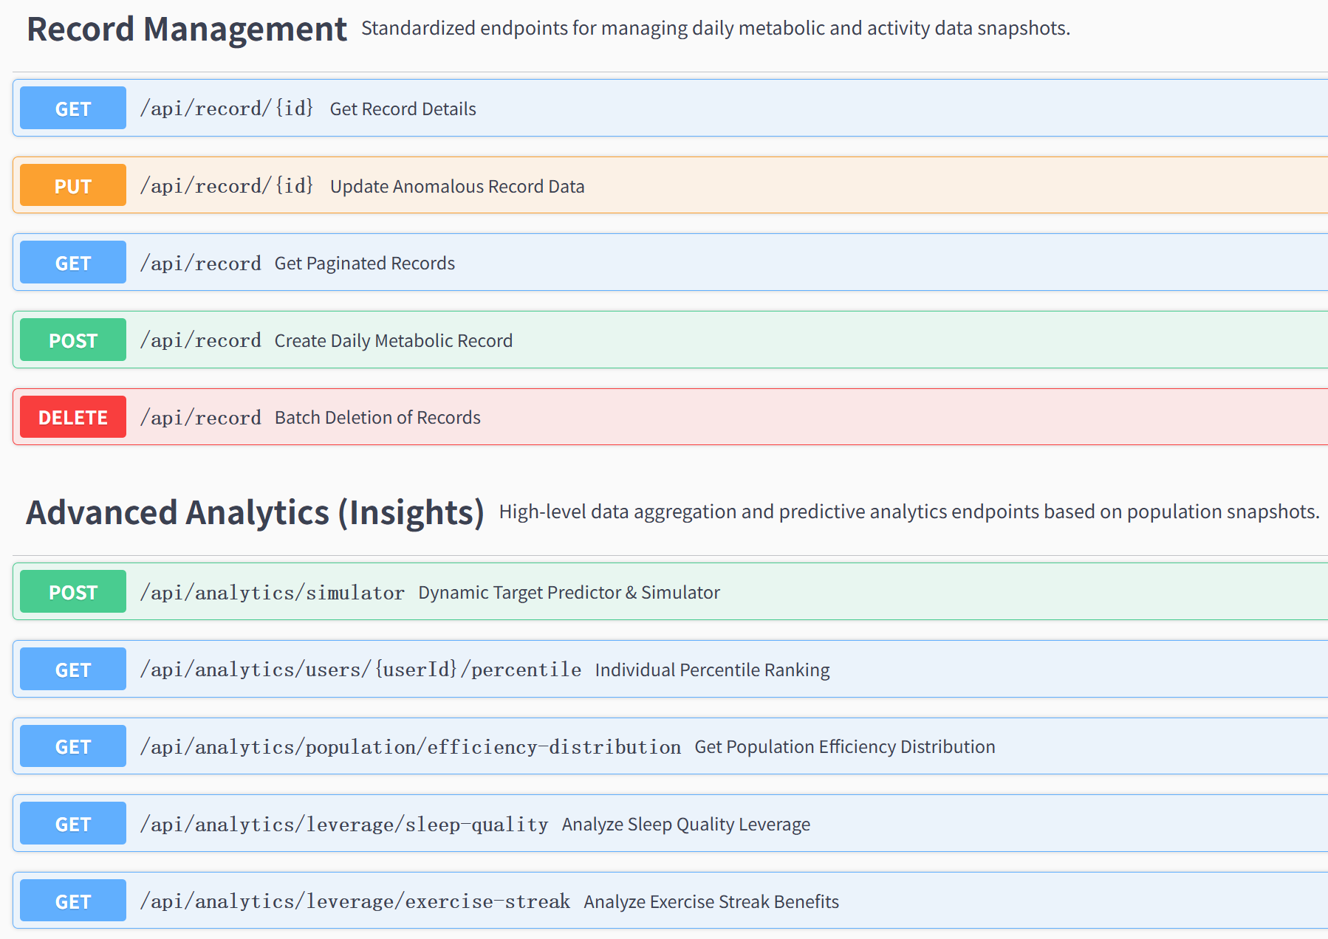
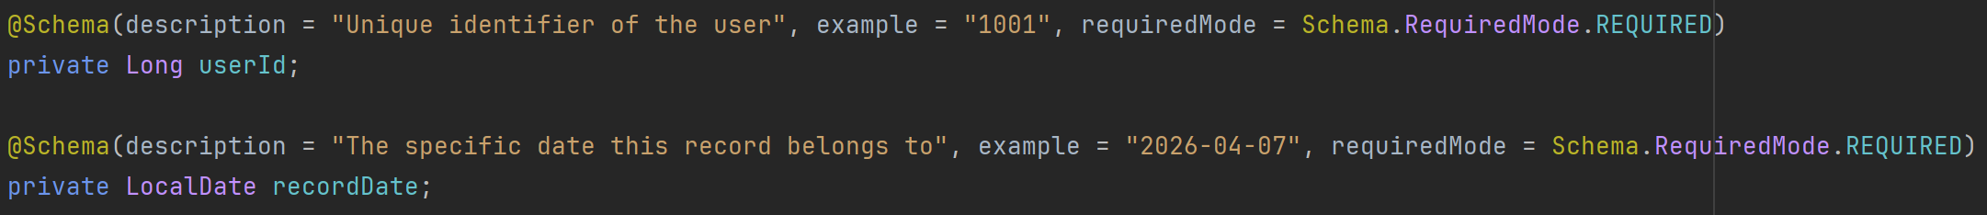
API Documentation Overview
API Doucumentation Screenshot
Standardized CRUD endpoints for secure daily data ingestion, paginated retrieval, and anomaly correction.
High-level endpoints delivering predictive behavioral simulations, individual percentile rankings, and macro-population health trends.
Code Example

Slide 5
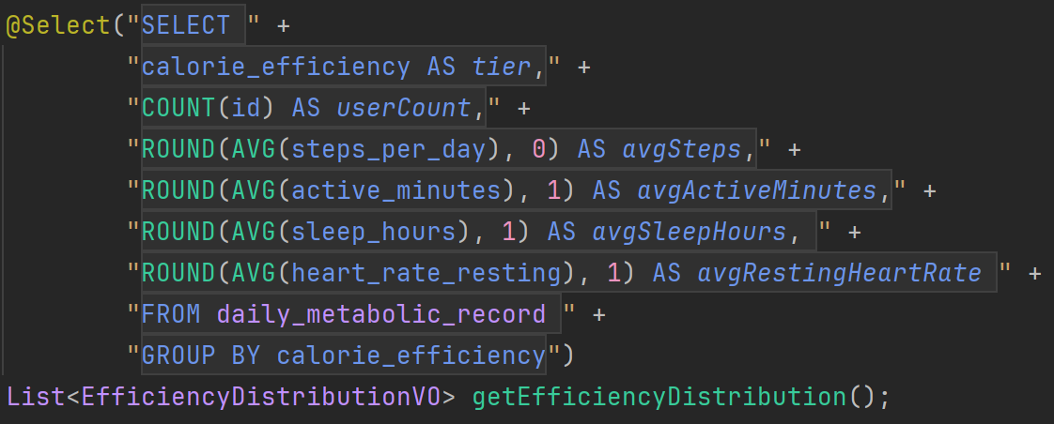
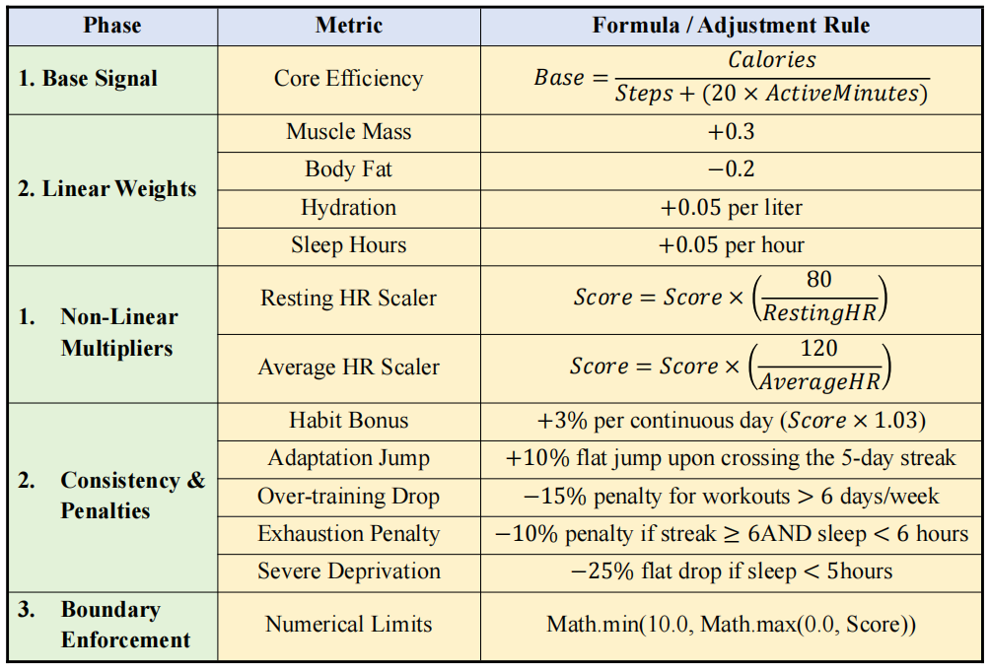
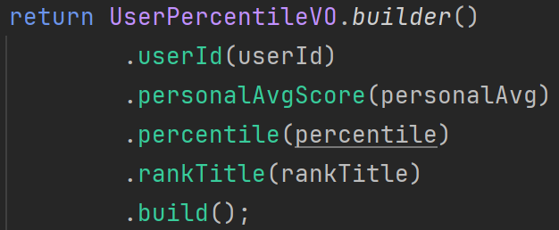
Technical Report Highlights
1
2
3
Security
DTO/VO Pattern: Security & Isolation
Performance
Database Offloading: Performance Optimization
Innovation
Deterministic Rule Engine: Predictive Simulation
Implemented an isolation layer to prevent over-posting attacks.
DTOs control input boundaries
VOs ensure analytical outputs are precisely shaped for frontend requirements.
Offloaded complex aggregations (e.g., efficiency distribution) to MySQL using native SQL.
This achieves O(1) application memory complexity and prevents OutOfMemoryErrors when processing 15,000+ records.
In-memory engine delivering instantaneous "what-if" health projections with zero database I/O latency.

Slide 6





Limitations & Future Work
Limitations
Future Work
1. Relies on raw userId parameters, risking Insecure Direct Object Reference attacks.
1. Integrate Spring Security with JWT for robust, stateless authentication.
2. Complex nested subqueries (e.g., percentile rankings) strain MySQL CPU under high concurrent traffic.
2. Introduce a Redis in-memory caching layer via Spring Cache to serve macro-analytics.
Current Architecture
Future Architecture
Spring
Security
Redis
Client
Spring
Boot
MySQL
Client
Spring
Boot
MySQL

Slide 7
References
[1]. Parashar, M., 2024. Close to realistic Calorie efficiency dataset. [dataset] Kaggle. Available at: https://www.kaggle.com/datasets/parasharmanu/close-to-realistic-calorie-efficiency-dataset [Accessed 10 April 2026].

